Slide 1
Lateral Thoracic Decompression
S P E A R™ decompression needle system
Simplified Pneumothorax Emergency Air Release
Rev D 110618
Notes:
The following program was created specifically for the SPEAR™ decompression needle system orientation and training.
For questions, concerns or additional information please contact:
North American Rescue®, LLC
email: info@NARescue.com
Tel: 864.675.9800
Mail: 35 Tedwall Court Greer, SC 29650-4791
Fax: 864.675.9880

Slide 2
The following materials were developed for the purpose of
SPEAR™ decompression needle system orientation and training
Warranty: The SPEAR™ decompression needle system is a medical device, the use of which requires specific education and training. North American Rescue, LLC. warrants the SPEAR™ as merchantable expressly for the indication detailed. North American Rescue disclaims all other implied warranties relating to this product, to include use beyond this product’s identified purpose, and utilization by untrained personnel or legally unauthorized parties.
Caution: Federal Law restricts the SPEAR™ to sale by, or on the order of, a licensed physician.
Notes:
As with most modern medical devices, the SPEAR™ (Simplified Pneumothorax Emergency Air Release) decompression needle system meets rigid safety standards, governmental mandates, and the demanding expectation of clinicians worldwide.
The SPEAR™ decompression needle system was developed with attention to the latest presented and published scientific evidence, as well as guidance from today’s leading experts in the fields of Emergency Medicine, Trauma Surgery, Pulmonology, Critical Care, Combat Care, and Pre-Hospital Emergency Medicine.
The SPEAR™ Warranty and Advisory should be read and understood as a component of this program.

Slide 3
The following materials were developed for the purpose of
SPEAR™ decompression needle system orientation and training
Key Term: Tension Pneumothorax. A known life-threatening medical emergency which, if left untreated, may result in death.
Indication: For relief of tension pneumothorax in the adult patient.
Contraindications: Not intended for treatment of simple pneumothorax or hemothorax. The efficacy of this device has not been established in pediatric patients.
Warning: Failure to utilize this device properly may result in injury to cardiac, pulmonary, or vascular structures.
Notes:
The Key Term, Indication and Contraindications are further reinforced within this program.
WARNING: As with all invasive medical devices, usage is predicated on proper orientation and training, careful consideration of the indications, patient condition, review of potential contraindications, and a specific RISK versus BENEFIT analysis.
Failure to utilize this device according to the directions for use, didactic materials provided, and NAR recommended hands-on training MAY CAUSE FURTHER INJURY.

Slide 4
Objectives
At the conclusion of didactic and hands-on training, you should be able to:
Identify components and function
List indications, contraindications, and expected therapeutic benefits of thoracic decompression
Identify (right and left) lateral landmarks for thoracic decompression
Identify (right and left) anterior landmarks for thoracic decompression
List indications of successful thoracic decompression
Define potential complications of improperly performed thoracic decompression procedure
Discuss current scientific evidence as it relates to thoracic decompression
covered in anterior
insertion program
Notes:
At the conclusion of this specifically developed SPEAR™ didactic, and NAR recommended hands-on training program, the clinical provider should be able to:
Identify the SPEAR™ components and function.
List the indications, contraindications, and expected therapeutic benefits of thoracic decompression.
Identify the (right and left) lateral landmarks for thoracic decompression.
Identify the (right and left) anterior landmarks for thoracic decompression. Objective is GRAY on this slide because it will be covered in anterior insertion program. Suggestion – review and become competent with both insertion locations.
List the indications (signs and symptoms) of successful thoracic decompression.
Define the potential complications of an improperly performed thoracic decompression procedure.
Discuss current scientific evidence as it relates to thoracic decompression.
At the completion of clinical training consider offering both a written and skills competency evaluation.

Slide 5
decompression needle system Simplified Pneumothorax Emergency Air Release
Objective 1: components and function
Spin-Lock
SEVEN (7) key system features
Notes:
SPEAR™ (Simplified Pneumothorax Emergency Air Release) decompression needle system and training materials meet and exceed 11 April 18 TCCC Guidelines Change 17-02”.
The SPEAR™ is a robustly packaged complete assembly created to address documented failures and current management challenges in the field and critical care settings.
Length: 3.75 inches. KEY Point: Specific research (of both civilian and military patients) notes that the 3.75 inch length will improve thoracic decompression and chest injury management success rates (*based on an average 2.1 inches of skin to rib depth AND an additional average of 0.5 inches of rib to pleura depth).
Size: 10ga (10 French) catheter with distal fenestrations (holes) and soft distal tip. The fenestrations provide a 314% increase in air outflow when compared to a 14ga catheter, and a 74% increase in air outflow over a non-fenestrated 10ga. The catheter’s soft tip has been shown to lessen the likelihood of inadvertent penetration, or injury to the visceral pleura. IMPORTANT POINT: SPEAR™ catheter walls (external and internal lumen combined) have been shown to remain patent (open) during routine usage. Catheter length has been shown to remain in position (on both larger and smaller adult patients) during treatment and transport (movement).
Needle tip has been modified (to a bi-beveled cutting blade with an adjusted angle of entry) to improve penetration through varying types of tissue. This modification offers clinicians enhanced entry control (which prevents “explosive entry” and penetration failure, thus improving patient safety). The catheter has been designed with NVG-friendly centimeter markings along its length for precise depth control (a key factor to improve patient safety) during placement.
Needle and catheter are conjoined by a novel spin-lock preventing, premature separation during SPEAR™ placement (a documented failure point in ALL other needle decompression systems).
A one-way valve is contained within this system and attached (via slip-tip) to the proximal end of the needle hub. This one-way valve is designed for clinician directed attachment to the catheter during patient treatment. The one-way valve may also be connected to a low volume suction system as needed.

Slide 6
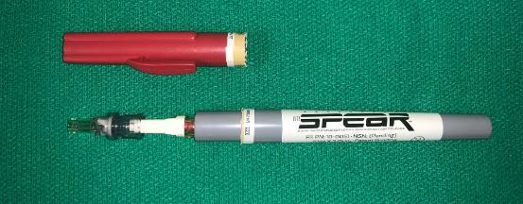
Objective 1: components and function (removal from protective case)
1
2
in protective case (sterile)
sterile seal broken (twist off)
3
case cap removed (exposing proximal needle set)
Notes:
The SPEAR™ decompression needle system is packaged in a proven, robust hard-shell case, with an assurance seal indicating sterility and lot number. As with all medical devices, labeling provides additional information regarding device length and size, as well as contact information for North American Rescue®, LLC.
Instructions for use accompany EACH needle set and should be reviewed during training efforts and emergent usage when needed.
To open:
Ensure integrity of safety seal
“Twist off” red cap, breaking safety seal
Remove red case cap, exposing SPEAR™

Slide 7
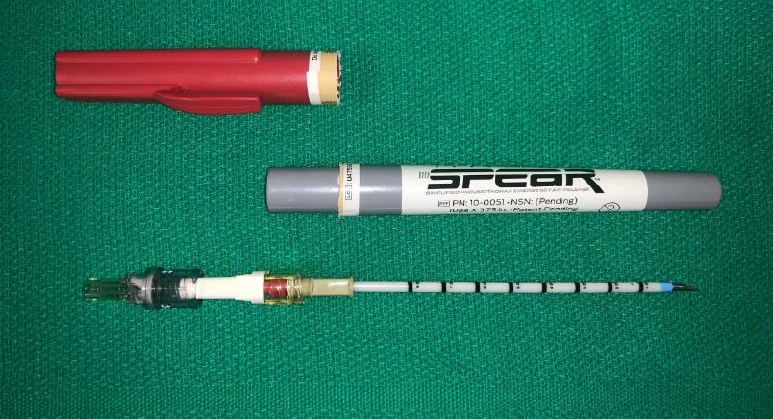
Objective 1: components and function (removal from protective case)
4
removed from case (pictured on sterile field)
Notes:
Continued from previous slide:
The SPEAR™ decompression needle system is packaged in a proven robust hard-shell case with an assurance seal indicating sterility and Lot number. As with all medical devices, labeling provides additional information regarding device length and size as well as contact information for North American Rescue®, LLC.
Instructions for use accompany EACH needle set and should be reviewed during training efforts and emergent usage when needed.
To open:
Ensure integrity of safety seal
“Twist off” red cap, breaking safety seal
Remove red case cap, exposing SPEAR™
Remove SPEAR® and inspect device prior to usage

Slide 8
Objective 1: components and function
catheter disconnects from needle by releasing spin-lock (with ¼ turn)
catheter threads into position (while holding needle stationary)
Notes:
The SPEAR™ decompression needle system has a purposefully designed Slip-Lock between the catheter and the needle hub. The novel Spin-Lock is designed to prevent premature separation during insertion (a documented insertion failure point).
Once proper insertion depth has been achieved (≤ 3 cm or ≤ to 1.2 inches), and SPEAR™ has been oriented toward the mid-clavicle, separation of needle and catheter can be easily accomplished with a ¼ turn disconnect (“twist off”) and release.
Catheter may then be threaded (guided) into position along parietal pleural wall for maximal therapeutic benefit.

Slide 9
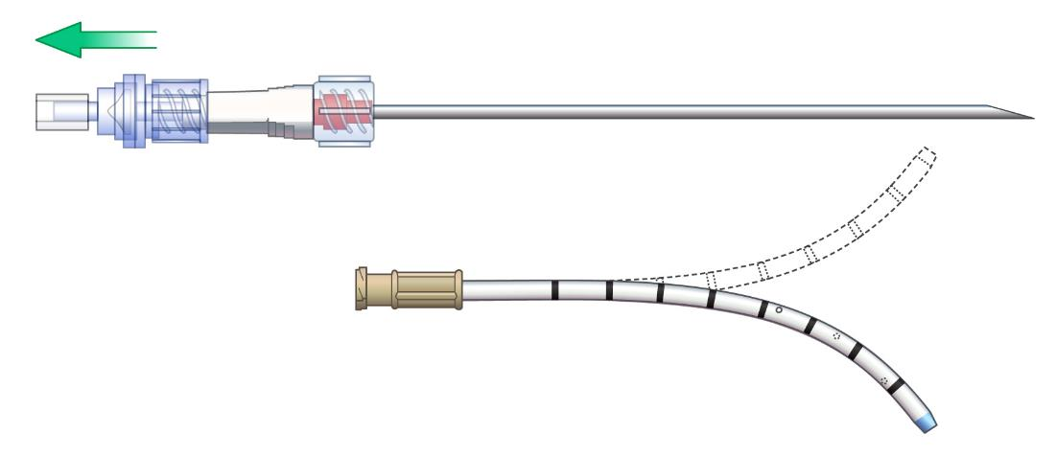
Objective 1: components and function
remove entire needle (after catheter has been threaded into position)
note catheter flexibility
Notes:
Note that SPEAR™ needle should be removed ONLY when the catheter has been threaded into position (an established failure point for needle decompression).
Note that 10ga catheter has improved flexibility to promote continued relief of thoracic pressure during critical patient management.

Slide 10
Objective 1: components and function
disconnect one-way valve from needle hub (safely secure needle in bio-hazard sharps container)
Notes:
A one-way valve is attached to the SPEAR™ needle hub.
The one-way valve is attached with a “slip-tip connection” and can simply be “pinched off” with one hand (in preparation for placement on the catheter’s proximal end).

Slide 11
Objective 1: components and function
attach one-way valve to catheter hub (auditory signal may be heard)
Notes:
Attach one-way valve to the catheter’s proximal hub as indicated.
Attachment can be achieved by standard medical connection.
Secure catheter per protocol or standard.
One-way valve may be attached to a low-pressure suction system as indicated.

Slide 12
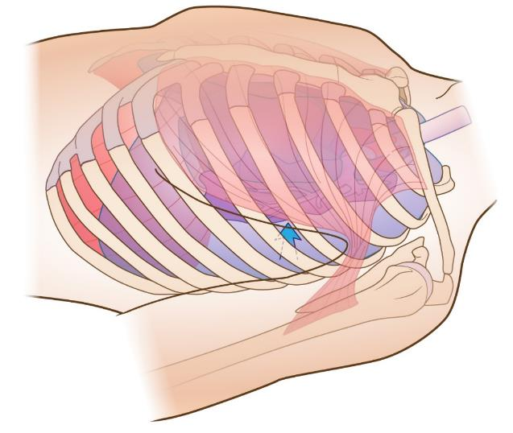
Objective 2: indication
tension pneumothorax:
a life-threatening emergency, which if left untreated,
may result in death
left lateral illustration of left sided tension pneumothorax
Notes:
A tension pneumothorax is known to be a life-threatening emergency, which if left untreated, may result in death.
NOTE: Illustration depicts left lateral view of patient WITH left-sided tension pneumothorax.

Slide 13
Objective 2: indication
indications: consider treatment of tension pneumothorax
when one or more of the following are present:
severe or progressive respiratory distress
severe or progressive tachypnea
absent or markedly decreased breath sounds
oxygen saturation less than 90%
shock
traumatic cardiac arrest without obvious fatal wounds (consider immediate placement of bilateral SPEAR™ decompression needles and consider ALL other possible causes)
Notes:
Indications: Treatment of a tension pneumothorax should be considered when one or more of the following are present:
Severe or progressive respiratory distress.
Severe or progressive tachypnea.
Absent or markedly decreased breath sounds.
oxygen saturation less than 90%.
Shock.
Traumatic cardiac arrest without obvious fatal wounds. (consider immediate placement of bilateral SPEAR™ decompression needles and consider ALL other possible causes).

Slide 14
Objective 2: contraindications
contraindications: The S P E A R™ is not intended for treatment of simple pneumothorax or hemothorax
efficacy of the S P E A R™ has not been established in
pediatric patients
Notes:
Contraindications: The S P E A R™ is not intended for treatment of simple pneumothorax or hemothorax.
Efficacy of the S P E A R™ has not been established in pediatric patients.

Slide 15
Objective 2: therapeutic benefits
thoracic decompression should improve one or more of the following:
respiratory distress
relief of restrictive pressure between the parietal and visceral pleura (secondary to injury or significant medical complication)
oxygen saturation (≥ 90% may be dependent on use of supplemental oxygen)
return of radial pulse or vital signs
Notes:
thoracic decompression should improve one or more of the following:
respiratory distress.
Relief of restrictive pressure between the parietal and visceral pleura (secondary to injury or significant medical complication).
oxygen saturation (≥ 90% may be dependent on use of supplemental oxygen).
Return of radial pulse or vital signs.

Slide 16
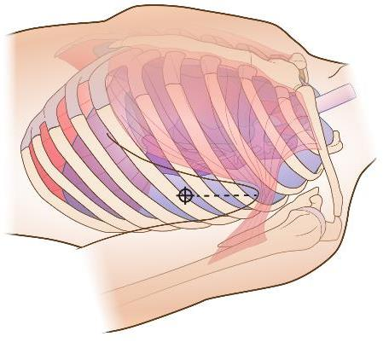
Objective 3: lateral insertion site
numbered
Intercostal
spaces
5
4
3
2
1
5
4
3
2
1
6
5
4
3
2
1
numbered ribs
6
5
4
3
2
1
4th intercostal space - anterior axillary line
5th intercostal space - anterior axillary line
site located superior to 5th rib
site located superior to 6th rib
Notes:
Lateral land-marking for thoracic decompression is critical for patient safety.
Note that thoracic decompression may be relieved at either the 4th or 5th intercostal space (consult your protocol or standards for specific verification).
IMPORTANT POINT: The images presented on this slide depict intercostal spaces and ribs that are numbered for clinician clarification and discussion.
Providers MUST ensure proper land-marking prior to SPEAR™ insertion.
NOTE: Insertion site is superior to the rib that is initially targeted. THIS IS A CRITICAL STEP to ensure proper placement location, avoidance of neurovascular bundle beneath each rib, and represents a known, safe starting position, from which the provider can control precise placement and insertion depth.

Slide 17
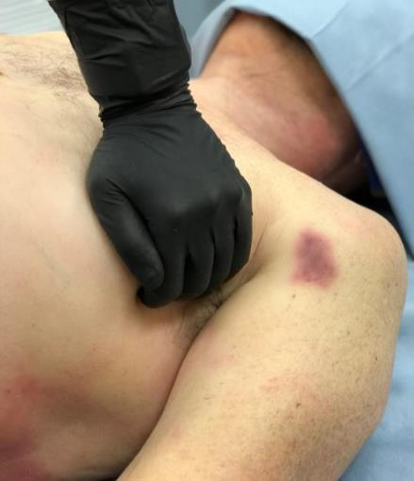
Objective 3: lateral insertion
insertion site
identification
anterior-axillary
mid-axillary
4th ICS
posterior-axillary
safe zone
mark & cleans site
area over 4th & 5th
intercostal spaces
anterior axillary line
identify 4th or 5th intercostal space
5th ICS
anterior axillary line (or between anterior and mid axillary lines)
Notes:
The insertion sites commonly accepted for lateral decompression include the 4th or 5th intercostal space on the anterior axillary line (traditionally, insertion has also been viewed as acceptable between the anterior and midaxillary lines. Consult protocol or standards for verification).
Once site has been correctly identified, it should be thoroughly cleansed according to protocol and applicable standards of care.

Slide 18
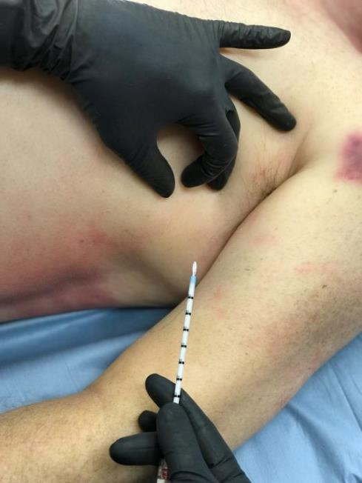
site verification
and framing
site reverification
4th ICS
insertion site is
superior to
targeted rib
5th ICS
Objective 3: lateral insertion
Notes:
Once site has been properly cleansed, preparations for SPEAR™ insertion can be completed.
Note site “framing” and “reverification” in the image provided. Framing tightens the skin to improve penetration.
Site reverification (of the targeted rib) ensures that the SPEAR™ needle tip will FIRST be placed against the rib.

Slide 19
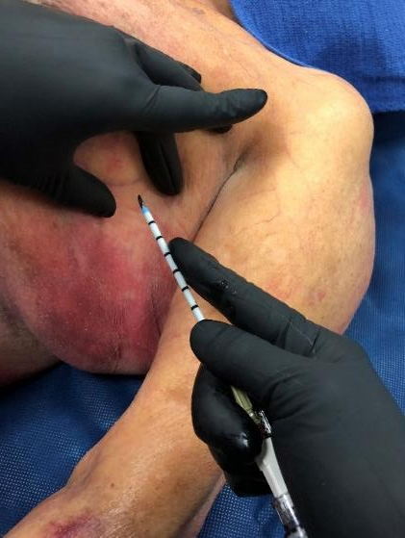
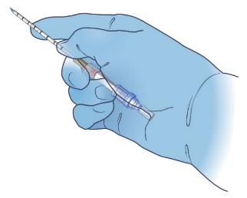
4th ICS
needle set stabilization improves precision placement and
depth control
5th ICS
Objective 3: lateral insertion
Notes:
During initial penetration through the skin, it is imperative that the tissue be stretched and that the provider is targeting the rib BELOW the intended insertion site.
NOTE: In the provided image, the clinician is stabilizing the needle set and will provide DEPTH CONTROL with their index finger.

Slide 20
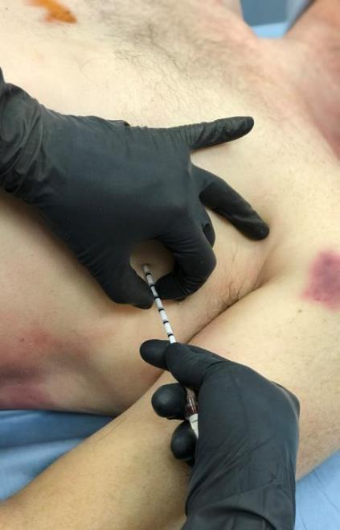
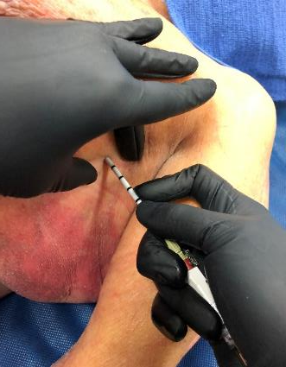
insertion site
framing
needle set must remain
perpendicular to chest wall
during insertion
insertion site is
superior to targeted rib
hand stabilization
needle set stabilization
with finger tip depth control
Objective 3: lateral insertion
Notes:
Once the SPEAR™ has penetrated the skin and adipose tissue, it should be firmly placed against the rib (this is a critical identification step to ensure patient safety).
When the SPEAR™ needle tip has been placed against the targeted rib, the provider should MARK and HOLD ≤ 3 centimeters above the skin.
Depth marking is critical to the next phase of insertion (which is entry of the needle set within the pleural space).

Slide 21
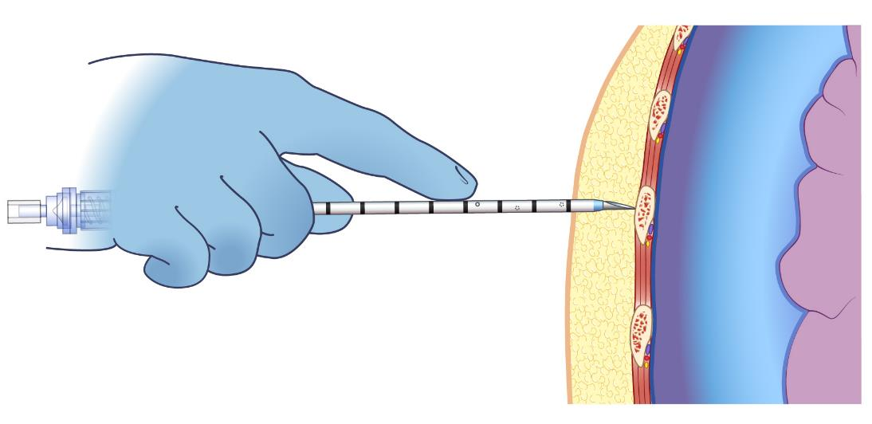
needle set stabilization
with finger tip depth control
insertion site is
superior to targeted rib
Objective 3: lateral insertion
Notes:
Illustration on this slide is for additional clarity of previous point.
Once the SPEAR™ has penetrated the skin and adipose tissue, it should be firmly placed against the rib (this is a critical identification step to ensure patient safety).
Once the SPEAR™ needle tip has been placed against the targeted rib, the provider should MARK and HOLD ≤ 3 centimeters above the skin.
Depth marking is critical to the next phase of insertion (which is entry of the needle set within the pleural space).

Slide 22
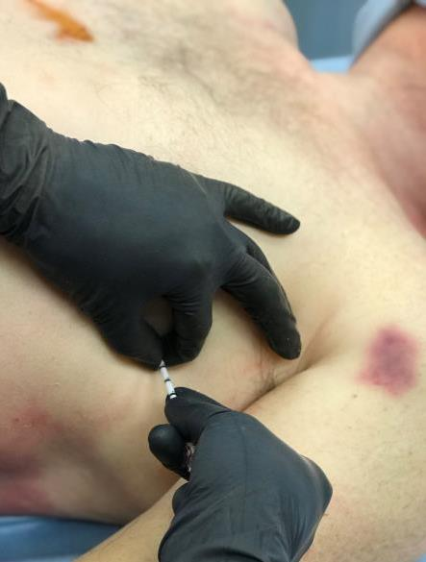
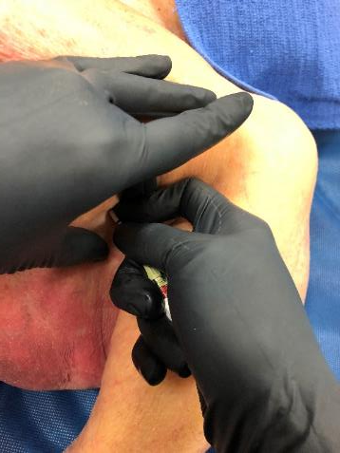
needle set stabilization
with finger tip depth control
needle set must remain
perpendicular to chest wall
during insertion
KEY POINT:
stabilization and control
target rib and precisely
penetrate chest wall to
prevent further injury
insert SPEAR™ superiorly
over targeted rib
insert ≤ 3 cm into pleura cavity
Objective 3: lateral insertion
DO NOT “BURY” OR “HUB” NEEDLE SET
Notes:
With ≤ 3 centimeters identified, the provider must carefully move the SPEAR™ needle tip superiorly over the targeted rib and guide the assembly into the thoracic cavity. Images on this slide depict two methods. Note that each image in this slide demonstrates the SPEAR™ being advanced a specific distance with “finger tip control.”
This step is safely accomplished by pinning ≤ 3 centimeters above the tissue WHILE the needle tip is against the rib. Note that the provider ASSURES proper insertion depth is achieved (and NOT exceeded).
Critical Point: Ensure that SPEAR™ placement is accomplished with the needle set perpendicular to the thoracic wall.
It is well established that some experienced providers can appreciate (feel) needle set penetration of the parietal pleura (thus indicating the appropriate initial needle set penetration depth). Regardless of depth control method - DO NOT “BURY” or fully extend ANY decompression needle into the thoracic cavity.
*Air under pressure may release from the thoracic cavity at this point.

Slide 23
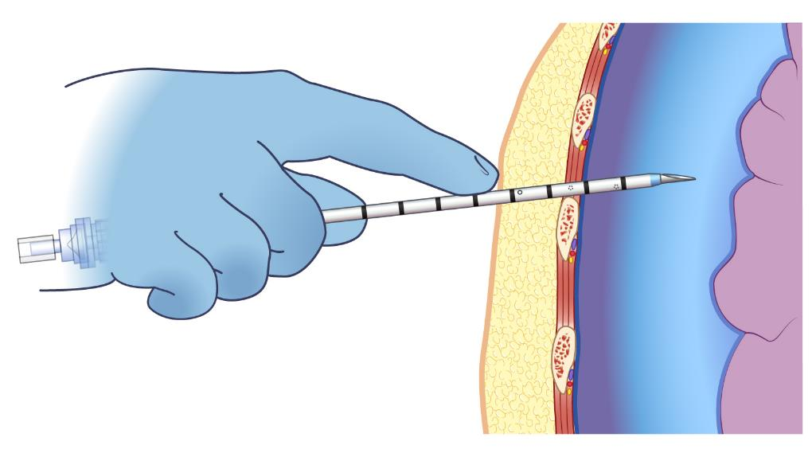
Objective 3: lateral insertion
KEY POINT:
stabilization and control
target rib and precisely
penetrate chest wall to
prevent further injury
insert superiorly
over targeted rib
insert ≤ 3 cm into pleura cavity
Notes:
The illustration on this slide is for additional clarity of previous point.
With ≤ 3 centimeters identified, the provider must carefully move the SPEAR™ needle tip superiorly over the targeted rib and guide the assembly into the thoracic cavity. Illustrations on this slide depict needle set entry over the targeted rib. Note that this image shows the SPEAR™ advanced the correct distance with “finger tip control.”
This step was safely accomplished by pinning ≤ 3 centimeter above the tissue WHILE the needle tip was against the rib. Note that the provider ASSURED proper insertion depth was achieved (and NOT exceeded).
Critical Point: Ensure that SPEAR™ placement is accomplished with the needle set perpendicular to the thoracic wall.
It is well understood and established that some experienced providers can appreciate needle set penetration of the parietal pleura (thus indicating appropriately achieved depth). Regardless of depth control method - DO NOT “BURY” or fully extend ANY decompression needle completely into the thoracic cavity.
*Air under pressure may release from the thoracic cavity at this point.

Slide 24
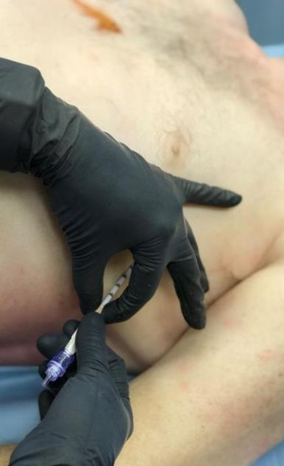
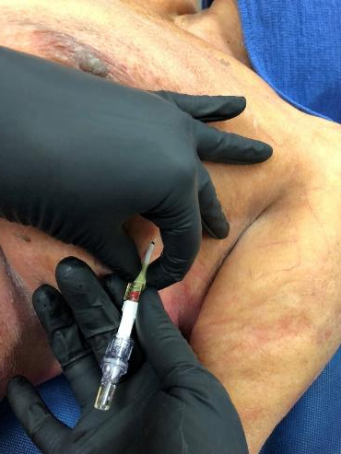
direct catheter
toward middle of clavicle
Prepare to advance catheter
while retaining needle
in stationary position
release needle
from catheter
release spin-lock
¼ turn
adjust needle set angle cephalad
Objective 3: lateral insertion
Notes:
Once the SPEAR™ has been placed into the thoracic cavity, DIRECT the assembly toward the middle of the clavicle.
Release the needle from the catheter by rotating the spin-lock ¼ turn. (This is a standard medical connection or “twist off” maneuver).
Critical Point: Ensure that SPEAR™ placement is accomplished with the needle set perpendicular to the thoracic wall.
*Air under pressure may release from the thoracic cavity at this point.

Slide 25
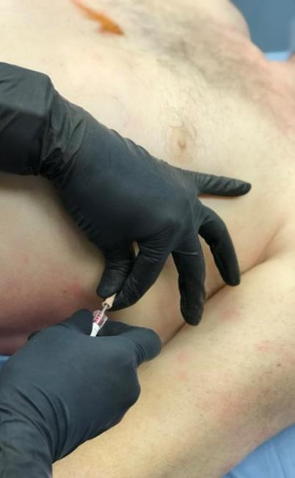
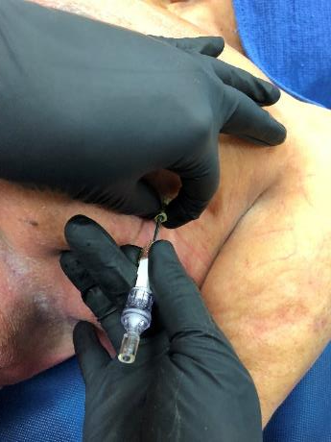
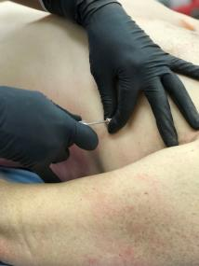
thread catheter
toward middle of clavicle
advance catheter
while retaining needle
in stationary position
advance catheter
needle set must
remain stationary
as a catheter guide
needle set must
remain at 90° angle
to thoracic cavity
Objective 3: lateral insertion
Notes:
Once catheter has been released from the needle, advance the catheter while keeping the needle stationary as a guide.
Critical Point: Ensure that SPEAR™ placement is accomplished with the needle set perpendicular to the thoracic wall.
*Air under pressure may release from the thoracic cavity at this point.

Slide 26
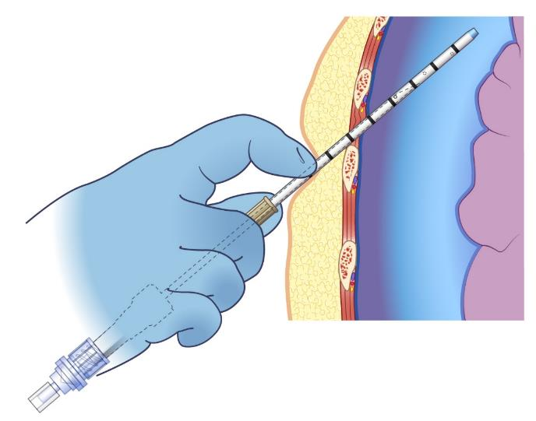
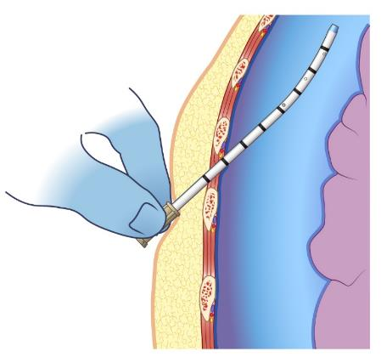
Objective 3: lateral insertion
completely thread catheter
into pleural cavity
thread catheter
toward middle of clavicle
catheter released from spin-lock
advance catheter while maintaining
needle in stationary position
Notes:
The illustrations on this slide are for additional clarity of previous point.
Once catheter has been released from the needle, advance the catheter while keeping the needle stationary as a catheter guide.
*Air under pressure may release from the thoracic cavity at this point.

Slide 27
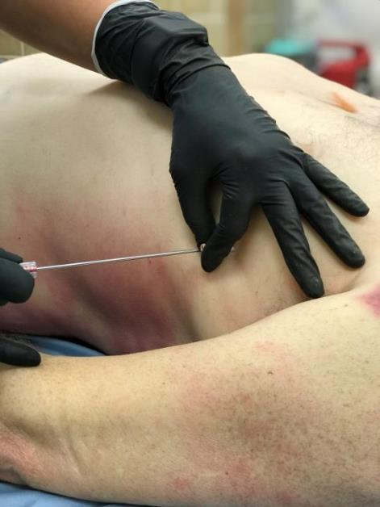
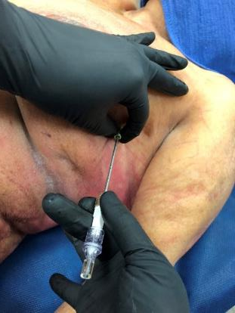
Objective 3: lateral insertion
advance catheter
completely
into pleural cavity
maintain needle in
stationary position
Notes:
Advance the catheter completely into the pleural cavity.
Critical Point: Ensure that SPEAR™ placement is accomplished with the needle set perpendicular to the thoracic wall.
*Air under pressure may release from the thoracic cavity at this point.

Slide 28
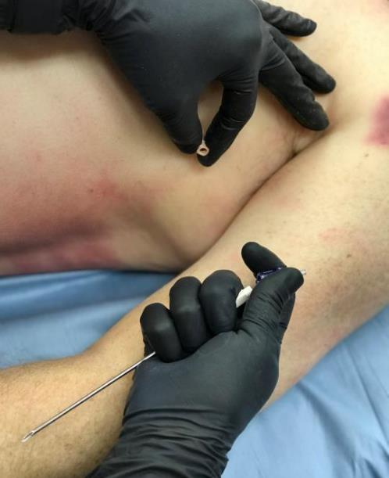
remove one-way valve from proximal end of needle hub
secure needle
in bio-hazard
sharps container
Objective 3: lateral insertion
Notes:
Remove one-way valve from proximal end of needle hub. The one-way valve is attached with a slip-tip and can simply be pinched off.
Secure the needle in a bio-hazard sharps container.
*Air under pressure may release from the thoracic cavity at this point.

Slide 29
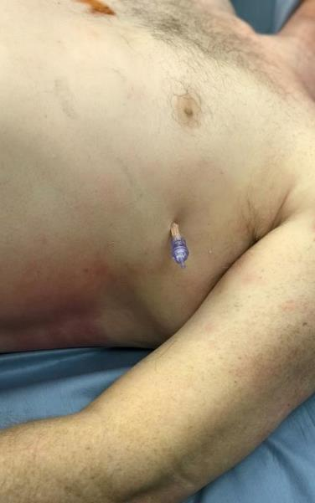
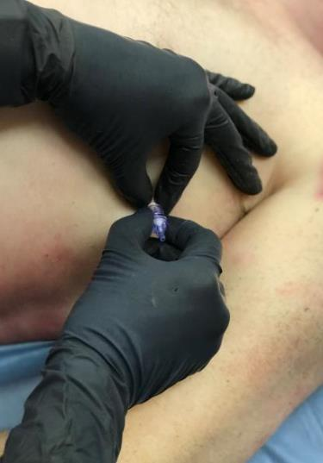
Objective 3: lateral insertion
catheter and one-way valve assemble may
be attached to low pressure suction
as needed
secure catheter according to local protocol and standards
attach one-way valve to proximal end of catheter (standard lock)
Notes:
Attach the one-way valve to the catheter hub (standard medical connection).
Secure the catheter according to local protocol and standards.
The catheter and one-way valve assembly may be attached to low pressure suction as needed.
Monitor the patient.

Slide 30
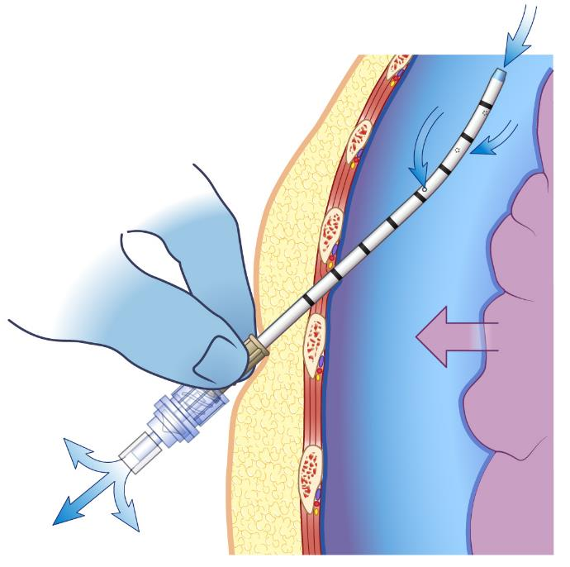
catheter and one-way valve assemble may
be attached to low pressure suction
as needed
Notes:
The illustration on this slide is for additional clarity of previous point.
Attach the one-way valve to the catheter hub (standard medical connection).
Secure the catheter according to local protocol and standards.
The catheter and one-way valve assembly may be attached to low pressure suction as needed.
Monitor the patient.

Slide 31
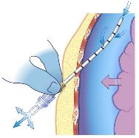
Objective 5: indications of successful thoracic decompression
successful thoracic decompression may have occurred if one or more of the following is observed:
improvement of respiratory distress
relief of air from catheter or one-way valve (valve may produce auditory signal)
improvement of oxygen saturation (≥ 90% may be dependent on use of supplemental oxygen)
return of radial pulse or vital signs
Notes:
Successful thoracic decompression may have occurred if one or more of the following is observed:
Improvement of respiratory distress.
Relief of air from catheter or one-way valve (valve may produce auditory signal).
Improvement of oxygen saturation (≥ 90% may be dependent on use of supplemental oxygen).
Return of radial pulse or vital signs.

Slide 32
Objective 6: complications
following thoracic decompression procedure, continually assess patient for complications:
Hemodynamic instability
Respiratory distress
Unilateral chest expansion
Decreased oxygen saturation
Bleeding
Catheter occlusion
Hematoma
if two needle decompression attempts fail to relieve condition consider other causes and potential treatments
IS THIS A CIRCULATORY PROBLEM?
Notes:
A patient should be monitored following any medical procedure. Thoracic decompression (by definition) is a life-saving procedure that is NOT without risk.
With continuous training, as well as safeguards and careful considerations, patient and provider risk can be mitigated.
Following thoracic decompression, continually assess the patient for complications. These should include (but not be limited to):
Hemodynamic instability
Respiratory distress
Unilateral chest expansion
Decreased oxygen saturation
Bleeding
Catheter occlusion
Hematoma
If two needle decompression attempts fail to relieve the suspected problem consider other causes and potential treatments. IS THIS A CIRCULATORY PROBLEM?

Slide 33
Objective 6: complications
potential adverse complications: of improper thoracic decompression
Death secondary to cardiac penetration
Lung injury
Vascular injury
Nerve damage
Pain
Numbness
Paralysis of intercostal muscle
Infection
Notes:
As with all invasive medical devices, potential adverse complications are a risk that MUST be considered. Most often, complications are the result of improperly performed interventions. Thoracic decompression is NOT WITHOUT RISK.
The FIRST step to avoiding injury is a complete understanding of the indications and contraindications for SPEAR™ usage. Each of the listed complications SHOULD be discussed WITH specific mitigation strategies integrated into the training program.
Complications are bolded in BLACK
Mitigation strategies presented in GRAY
Potential complications include (but are not limited to):
Death secondary to cardiac penetration (clinician should control thoracic penetration and restrict depth of needle set insertion)
Lung injury (insertion of needle set should be ≤ 3 cm past the parietal pleura)
Vascular injury (1. insertion site restrictions to the specific locations identified in this training program. 2. maintain proper needle set angle during insertion.
3. avoidance of needle set over penetration.
Nerve damage (ensure proper insertion site location “superior to targeted rib”)
Pain (if time permits, consider local anesthetic per protocol or standard)
Numbness (avoid insertion on the inferior aspect of the rib)
Paralysis of intercostal muscle (avoid insertion on the inferior aspect of the rib)
Infection (use aseptic technique)

Slide 34
Scientific Evidence
The S P E A R™ decompression needle system, and this presentation, were developed utilizing the latest published evidence, independent research, and the support of dedicated Military and Civilian medical professionals in Emergency Medicine, Trauma Surgery, Pulmonology, Radiology, and Pathology.
Clinical providers, regardless of their position, must dedicate themselves to the unrelenting truth that critical care is an evolution on behalf of those in need.
Butler F, Holcomb J, Shackelford S, et al. Management of the Suspected Tension Pneumothorax in Tactical Combat Care, TCCC Guidelines Change 17-02. J Spe Op Med. 2018; 18: 19-35.
*The aforementioned publication references ninety-six additional papers worthy of careful review.
Notes:
The S P E A R™ decompression needle system, and this presentation, were developed utilizing the latest published evidence, independent research, and the support of dedicated Military and Civilian medical professionals in Emergency Medicine, Trauma Surgery, Pulmonology, Radiology, and Pathology.
Clinical providers, regardless of their position, must dedicate themselves to the unrelenting truth that critical care is an evolution on behalf of those in need.
Butler F, Holcomb J, Shackelford S, et al. Management of the Suspected Tension Pneumothorax in Tactical Combat Care, TCCC Guidelines Change 17-02. J Spe Op Med. 2018; 18: 19-35.
*The aforementioned publication references ninety-six additional papers worthy of careful review.

Slide 35
Objective 7: scientific evidence
Nine Key Facets of Tactical Combat Care Guidelines Change 17-02
Continuation of aggressive approach to suspecting and treating tension pneumothorax
Emphasis of bilateral decompression in traumatic arrest
Addition of 10 Gauge catheter (length indicated in current guidelines differs from the S P E A R™)
Designates either Lateral or Anterior sites as acceptable for thoracic decompression
Addition of procedural elements (critical procedural differences are included within this material)
Defines successful thoracic decompression
Recommends ONLY two needle decompressions be attempted before moving on to circulation
Addition of materials that recommend consideration of tension pneumothorax in presentations of shock
Addition of finger thoracostomy (if presentation warrants - following two unsuccessful needle decompression attempts - and provider is trained)
Butler F, Holcomb J, Shackelford S, et al. Management of the Suspected Tension Pneumothorax in Tactical Combat Care, TCCC Guidelines Change 17-02. J Spe Op Med. 2018; 18: 19-35.
Notes:
There are nine Key Facets to thoracic decompression in the Tactical Combat Care Guidelines Change 17-02 that should be considered: Slide numbers correspond to Lateral Insertion Program
Continuation of aggressive approach to suspecting and treating tension pneumothorax.
There is discussion and some evidence that unwarranted needle decompressions have presented complications. While this is a valid concern, failure to recognize and treat tension pneumothorax remains a lethal reality. SPEAR™ training materials list documented indications for thoracic decompression.
Emphasis of bilateral decompression in traumatic arrest. See slide #13.
Failure to completely address ALL possible causes of traumatic arrest continues to present as a lethal concern. See slides #13 & 32.
Adds 10 Gauge. Length indicated in guidelines differs from the S P E A R™. Key points are found within the notes on slides #5 which offer details and specific clinical rationale for SPEAR™ length.
Designates either Lateral or Anterior sites as acceptable for thoracic decompression. SPEAR™ training materials [slides, video, and NAR recommended hands-on skills training] comprehensively review [right and left] lateral and anterior thoracic decompression sites.
Addition of procedural elements. SPEAR™ insertion differs significantly from that which is included within current TCCC guidelines and some institutions. See SPEAR™ procedural insertion techniques, for lateral and anterior sites, to obtain complete details and specific clinical rationale.
Defines successful thoracic decompression. SPEAR™ training materials identify key components of successful thoracic decompression. See slides # 15 & 31.
Recommends ONLY two needle decompressions be attempted before moving on to circulation. See slides #13 & 32.
Addition of materials that recommend consideration of tension pneumothorax in presentations of shock. See slide #13.
Addition of finger thoracostomy when presentation warrants. Provider has attempted two needle decompressions without success, and is authorized to perform procedure. See slides #32.

Slide 36
For additional information
about the
email: info@NARescue.com
Tel: 864.675.9800
Mail: 35 Tedwall Court Greer, SC 29650-4791
Fax: 864.675.9880
S P E A R™ decompression needle system
Simplified Pneumothorax Emergency Air Release
Notes:
Thank you for participating in the SPEAR™ decompression needle system orientation and training.
If you have any questions, concerns or would like additional information please contact:
North American Rescue®, LLC
email: info@NARescue.com
Tel: 864.675.9800
Mail: 35 Tedwall Court Greer, SC 29650-4791
Fax: 864.675.9880

